Slide 1
Deep Learning
A brief history of the technology and where it can make an impact
Meet Gandhi
Data & Applied Scientist, Microsoft

Slide 2
Where?
Problems that can be solved by deep learning

Slide 3
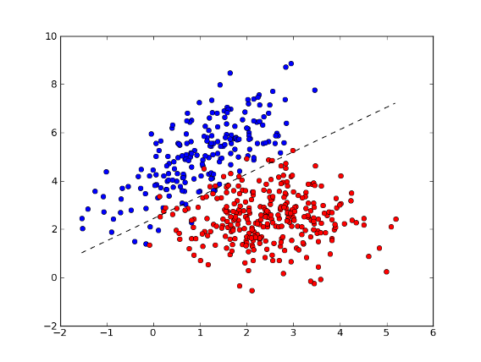
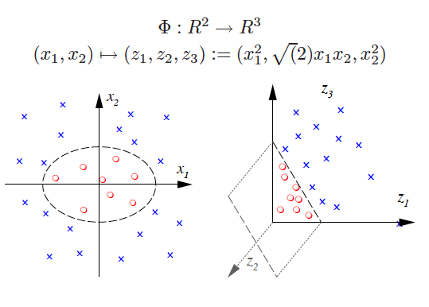
Classification Problem
Vs.
Need for a classifier to be able to learn features automatically from data
Classifier is able to separate +/- classes from the new feature space
Solution - Feed-forward neural network

Slide 4
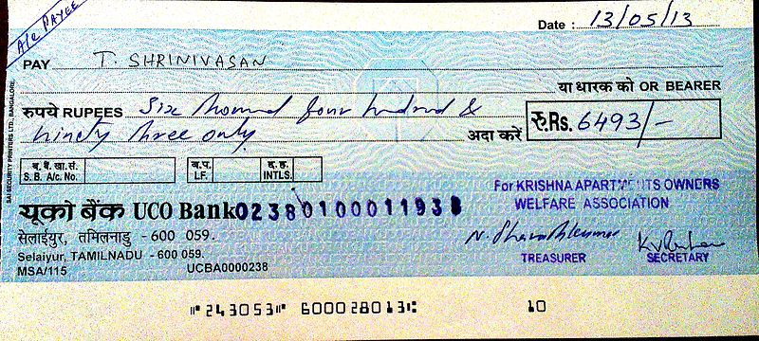
Computer Vision Problem
Example : Recognizing digits from text in an image
Solution - Convolutional neural network

Slide 5
Sequence Problem
My financial condition is good, not bad at all
My financial condition is bad, not good at all
Significance of ordering of words in addition to their presence/absence
Solution - Recurrent neural network

Slide 6
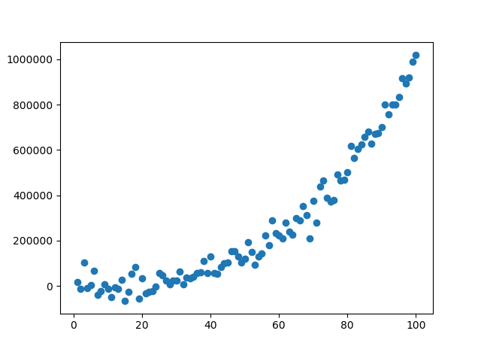
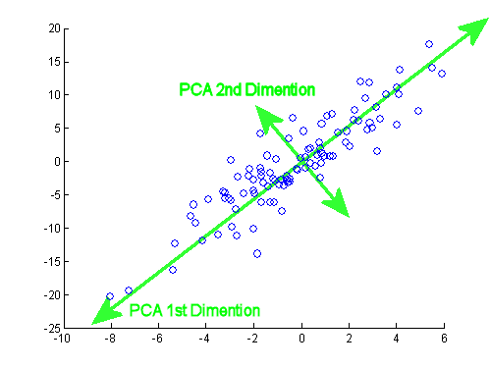
Dimensionality Reduction Problem
Lower dimensional manifold can be non-linear
Solution – Autoencoders

Slide 7
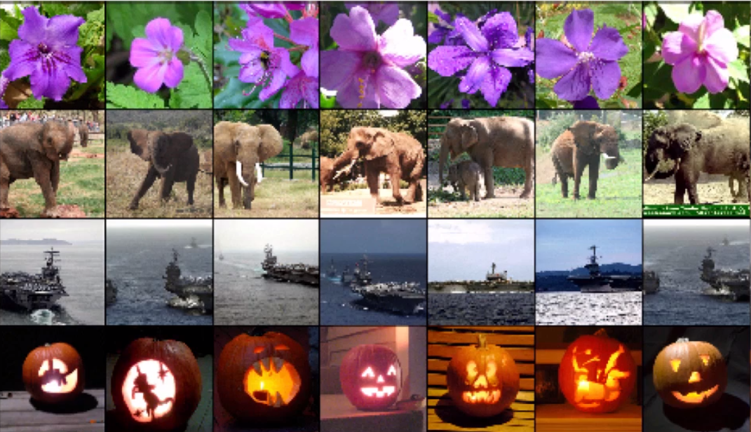
Information Storage/Retrival
Need to learn lower dimensional representation of rich images
Solution – Restricted Boltzmann machine

Slide 8
Other areas where deep learning is used
Collaborative Filtering
Feature Learning
Topic Modeling

Slide 9
Manifestations of deep learning
Deep Learning
Convolutional Neural N/W
Recurrent Neural N/W
Autoencoder
Hopfield Nets
Feed-forward Neural N/W
Restricted Boltzmann machine
Deep Belief net

Slide 10
What?
Deep learning – History and importance

Slide 11
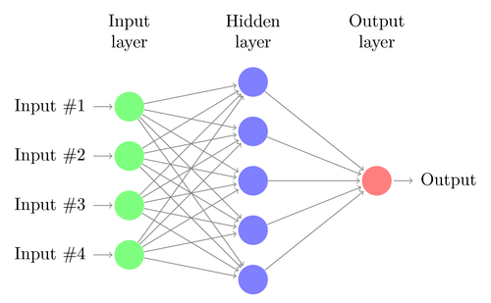
Feed-Forward Neural Network
Hidden layers will learn non-linear features

Slide 12
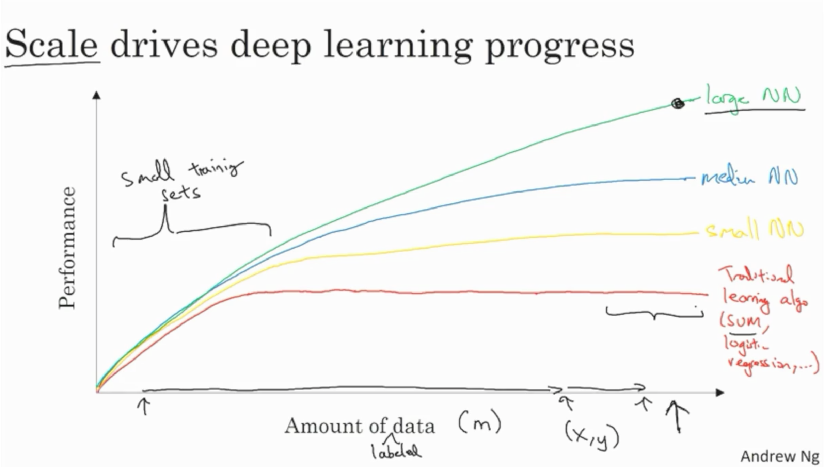
Why Deep Learning is so famous
Deep learning does not saturate as the data available increases unlike traditional classification techniques

Slide 13
Reason for resurgence of Deep Learning
Why deep learning was not considered viable in the 1990s
What has changed for deep learning in recent years
Lack of compute
Lack of big datasets
Lack of sound theoretical backing
Compute has increased drastically
Exponential growth in data availability and storage capacity

Slide 14
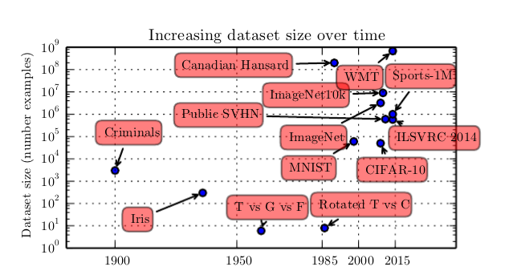
Increase in Dataset size

Slide 15
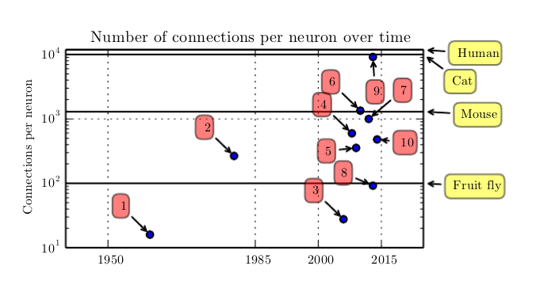
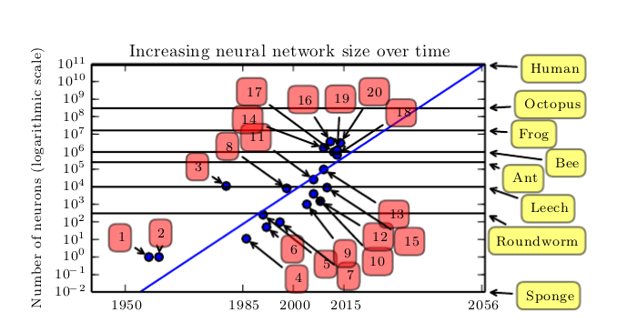
Increase in Number of Neuron Connection Per Neuron
Increase in Neural Network size over time

Slide 16
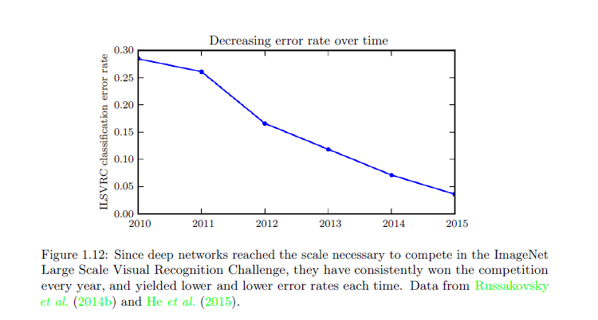
Error Rate Decline
ILSVRC is the litmus test for measuring how well the computer vision problem is solved
Dramatic reduction in error rate in recent years!

Slide 17
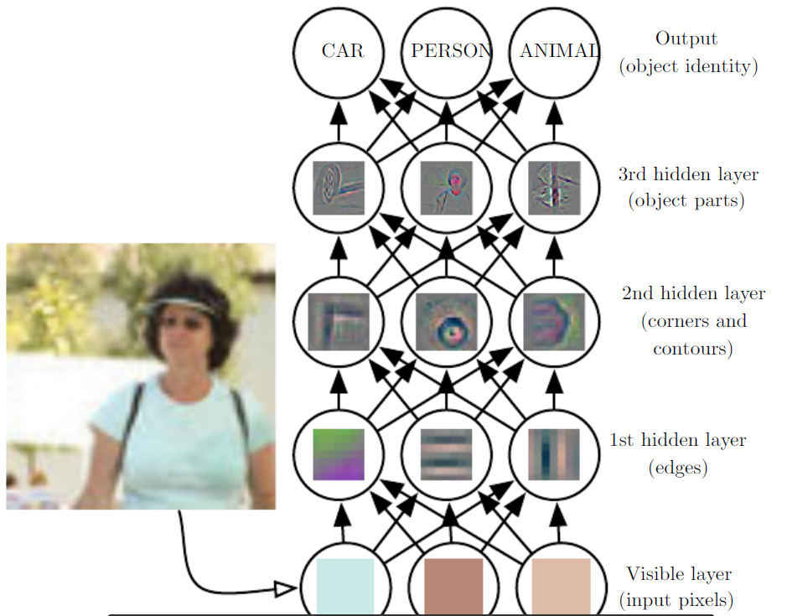
Deep learning to generate custom features automatically It’s as good as magic!
Learn right set of features automatically
Deep Visualization Toolbox
Notes:
http://yosinski.com/deepvis

Slide 18
How?
Deep learning to automatically identify and learn useful features

Slide 19
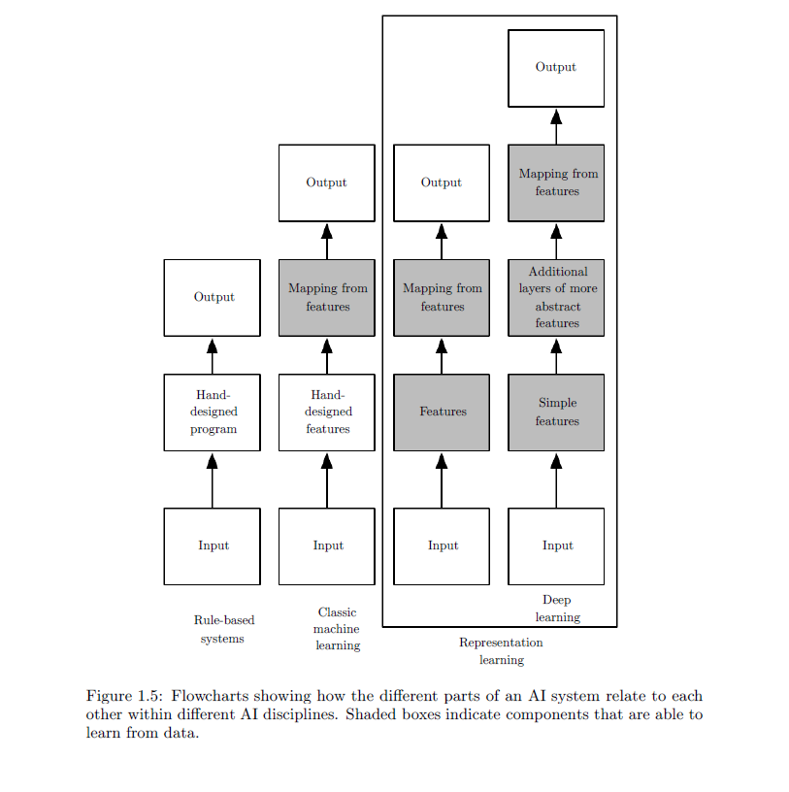
Representational Learning
Traditional ML
Use hand coded features to train the model
Deep learning
Model automatically learns the most useful features

Slide 20
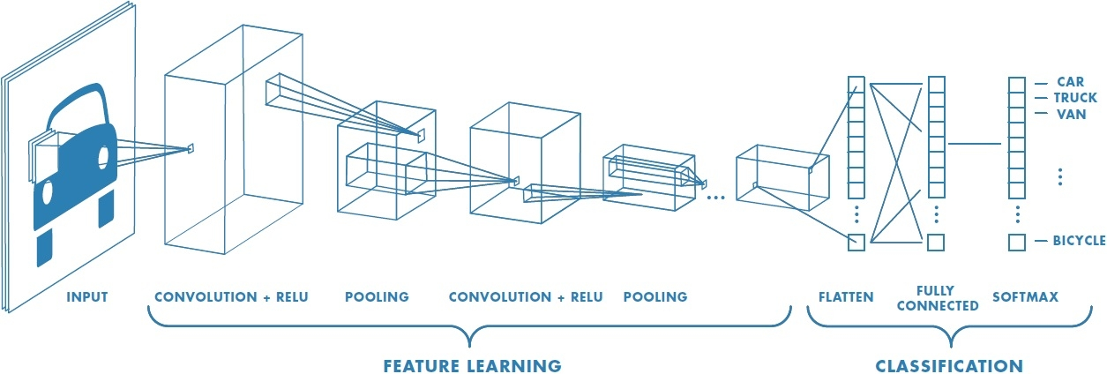
Convolutional Neural Network

Slide 21
Knowledge sharing

Slide 22

Recurrent Neural Network

Slide 23
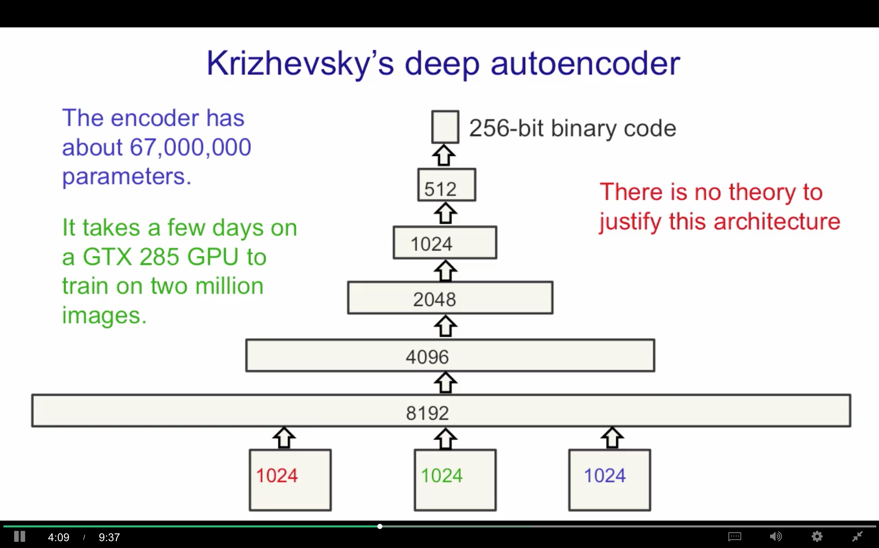
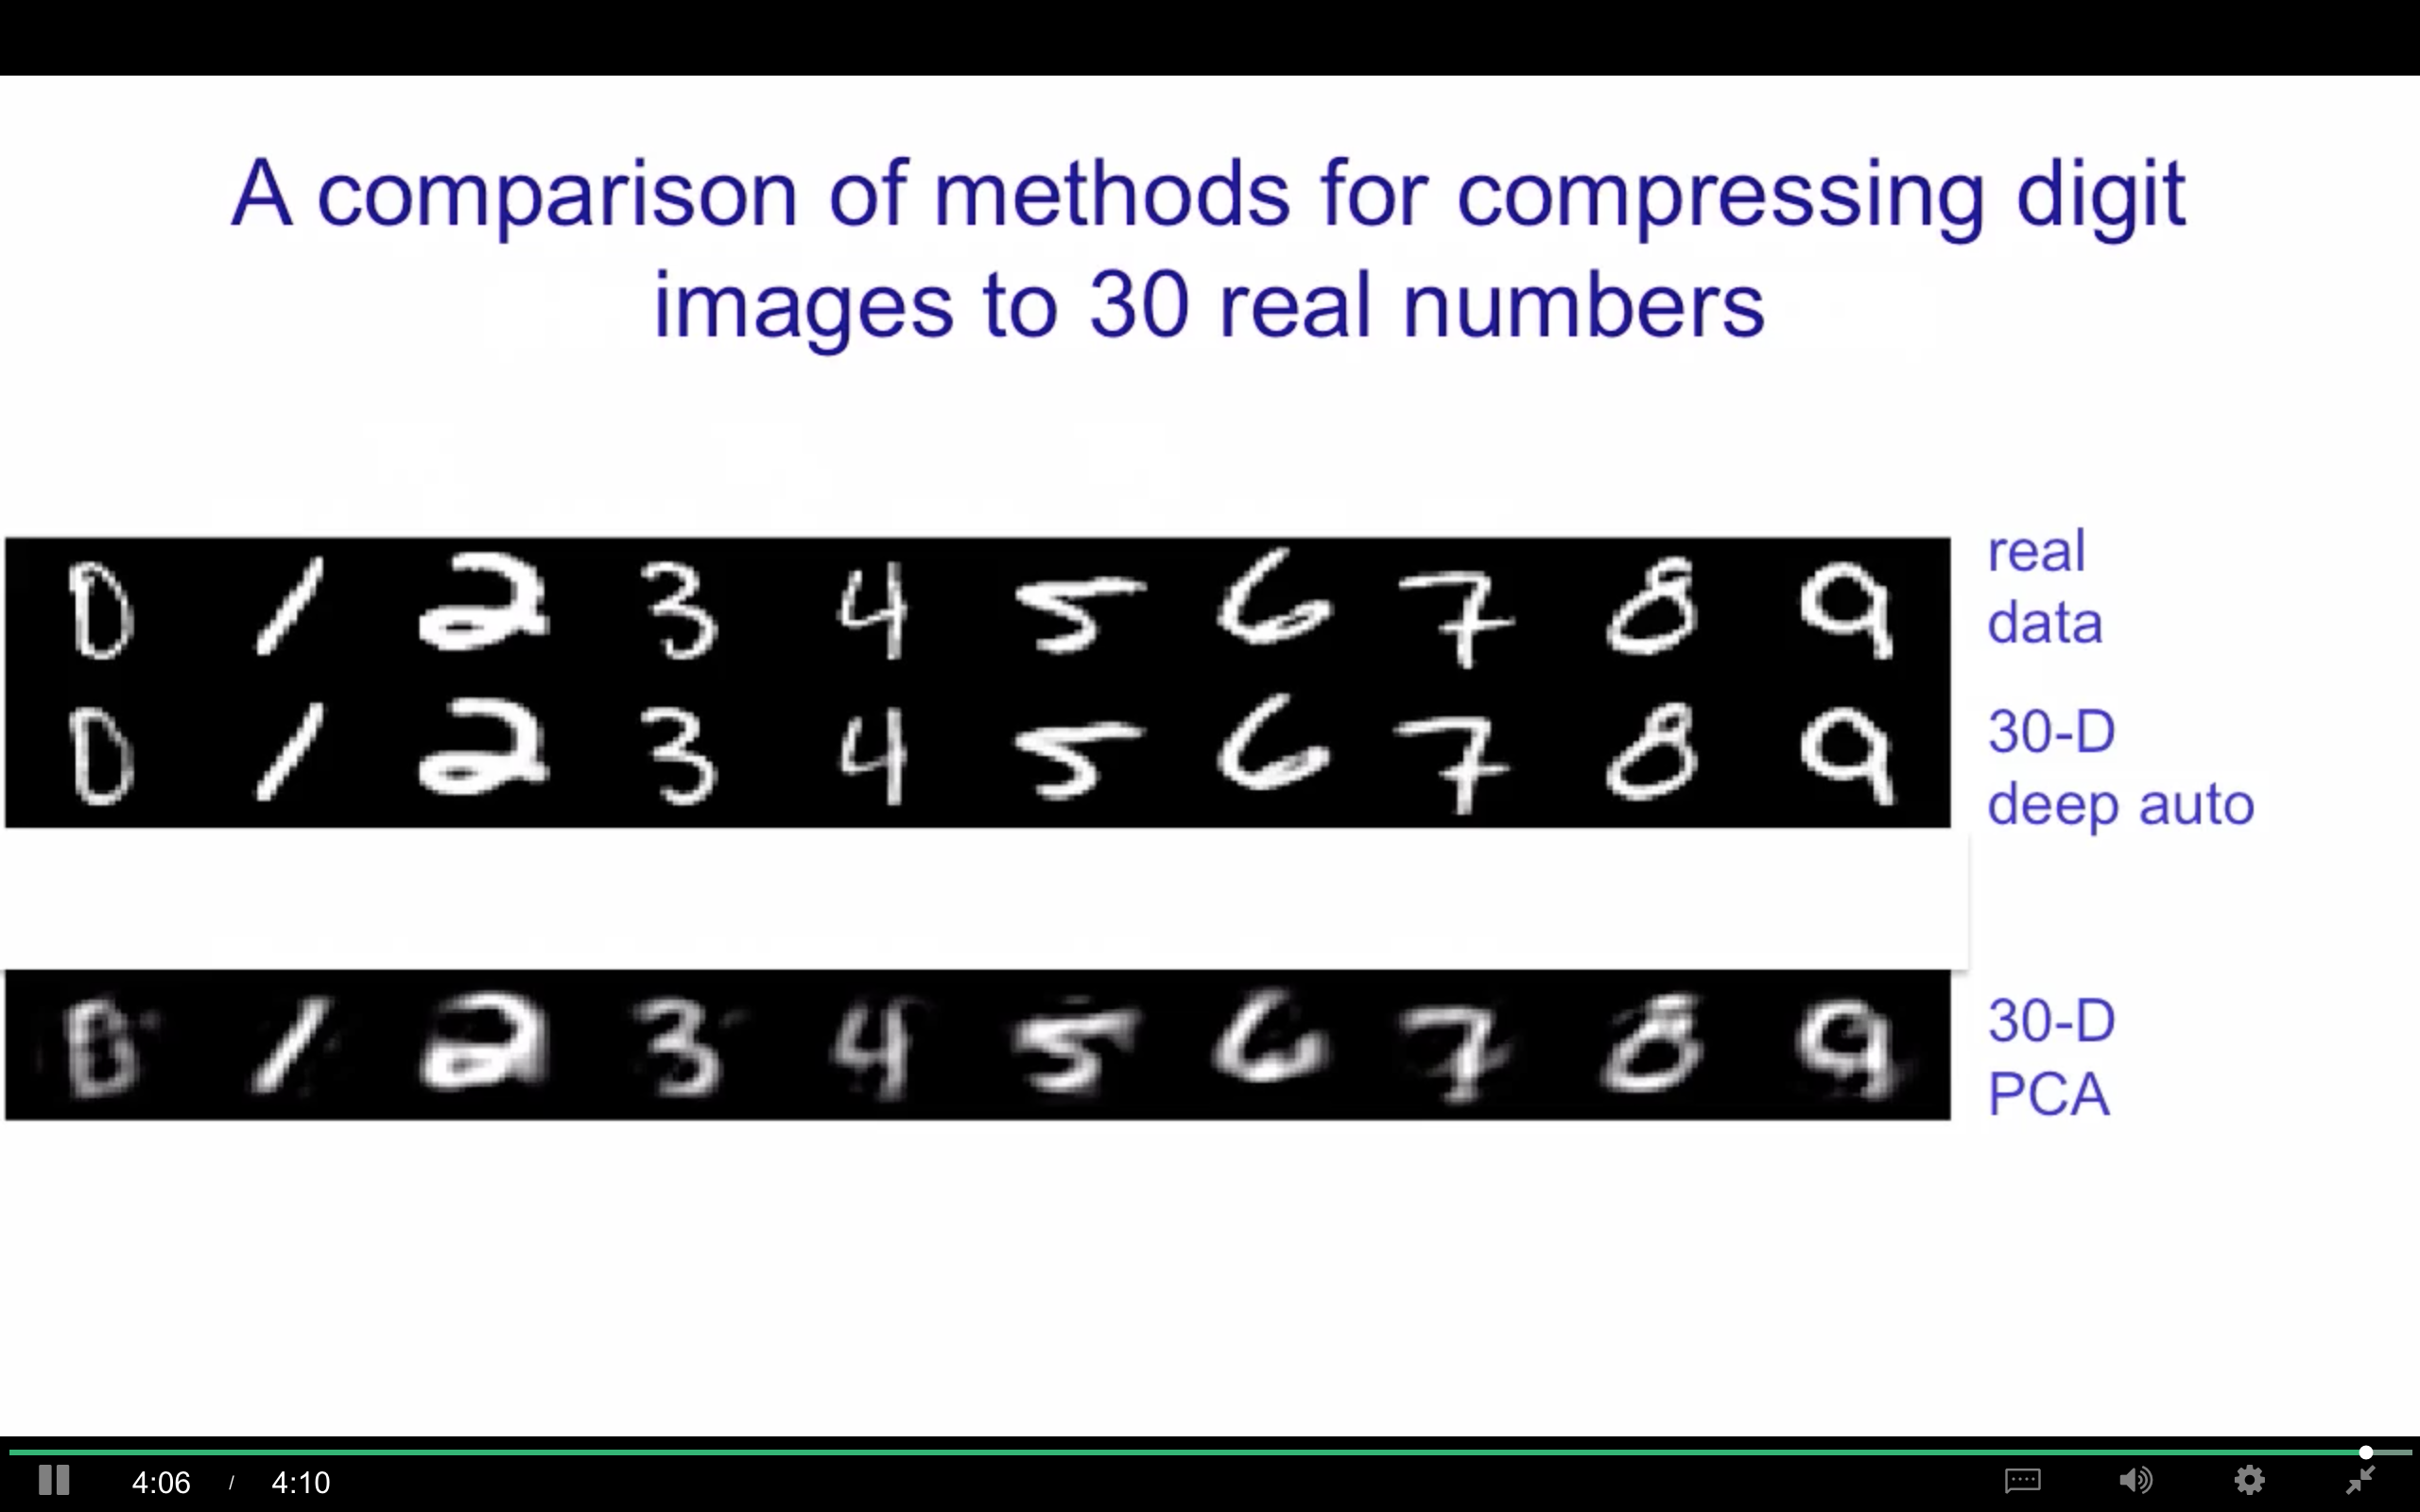
Autoencoders
Learn the lower level representation of data

Slide 24
What’s next?
Building deep learning models

Slide 25
Frameworks
Caffe/Caffe2
CNTK
DL4J
Keras
Lasagne
Mxnet
PaddlePaddle
TensorFlow
Theano
Torch

Slide 26
Hyperparameters
α
β
β₁, β₂
# Layers
# Hidden Units
Learning-rate decay
Mini-batch size
L1, L2
Dropout-rate
… and more

Slide 27
Q&A

